Slide 1
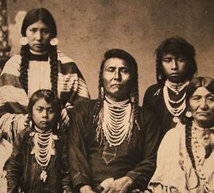
Native Americans
Part 1-
The First Americans

Slide 2

What do you think?
If you came in the school after school hours, how would you know if a classroom was being used?

Slide 3
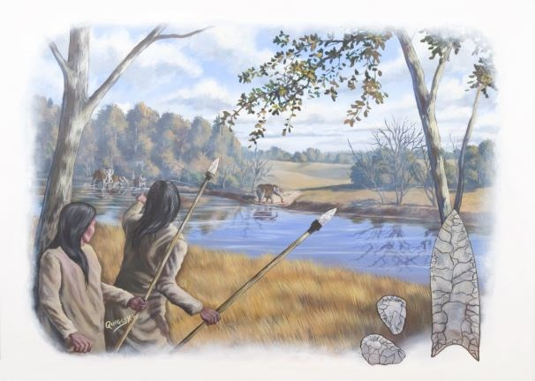
The first people to live on the land that now makes up the U.S. are known as Paleo-Indians.
“Paleo” comes from the Greek word “palaios” meaning ancient.

Slide 4
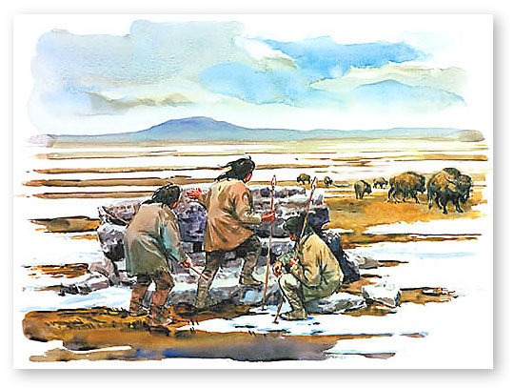
By studying skeletons, blood types, teeth, and genes, many scientists believe these Paleo-Indians migrated centuries ago from Asia.
To migrate means to move.

Slide 5
There are two main theories that explain how people migrated from Asia:
People walked from Asia to America across the Bering Land Bridge during the last ice age.
People travelled by boat from Asia to America.

Slide 6
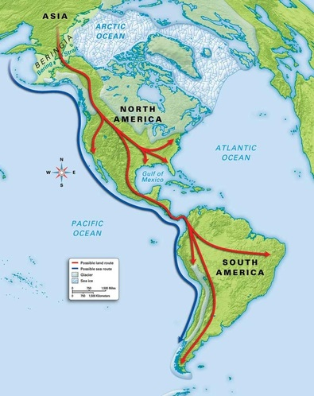

Slide 7
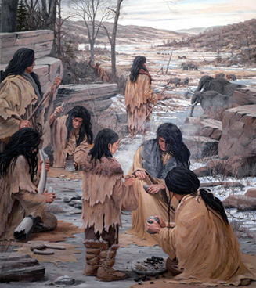
One early group of Paleo-Indians that lived in North America is known as the Clovis people.
There is some evidence that the Clovis people are the ancestors of several Native American tribes.

Slide 8
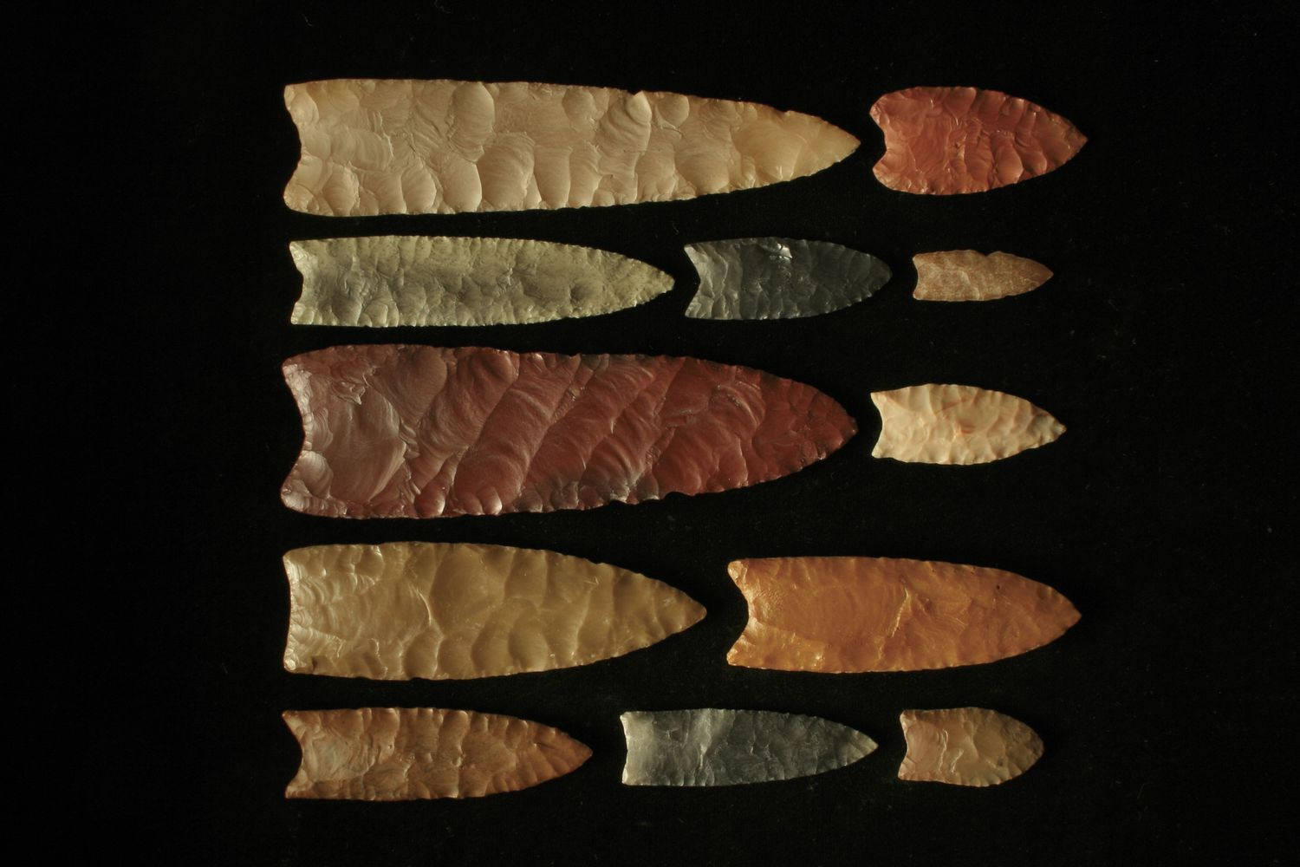
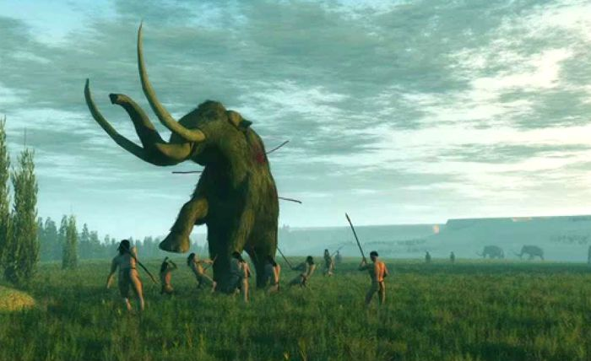
The Clovis culture is named for distinct stone tools found near Clovis, New Mexico, in the 1920s and 1930s.
The Clovis people hunted big animals like mammoths and mastodons.

Slide 9
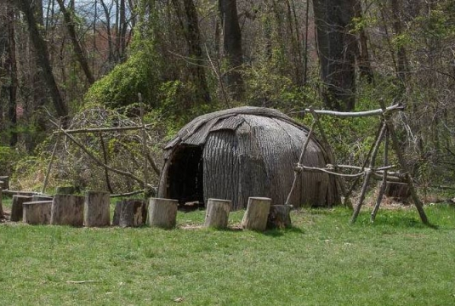
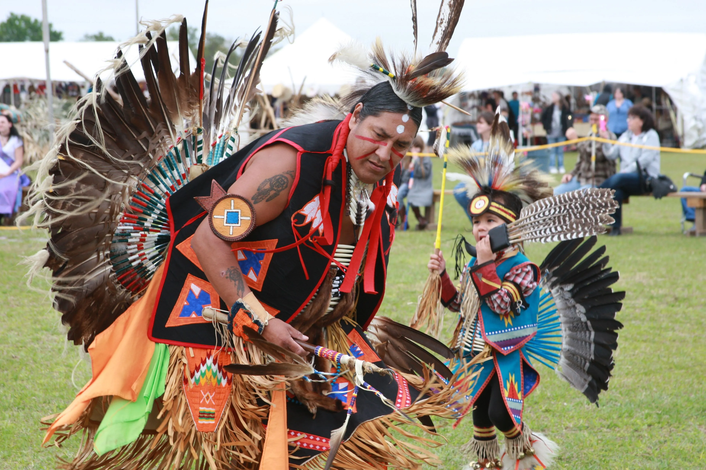
A culture is a way of life shared by people who have similar customs, language, and beliefs.

Slide 10
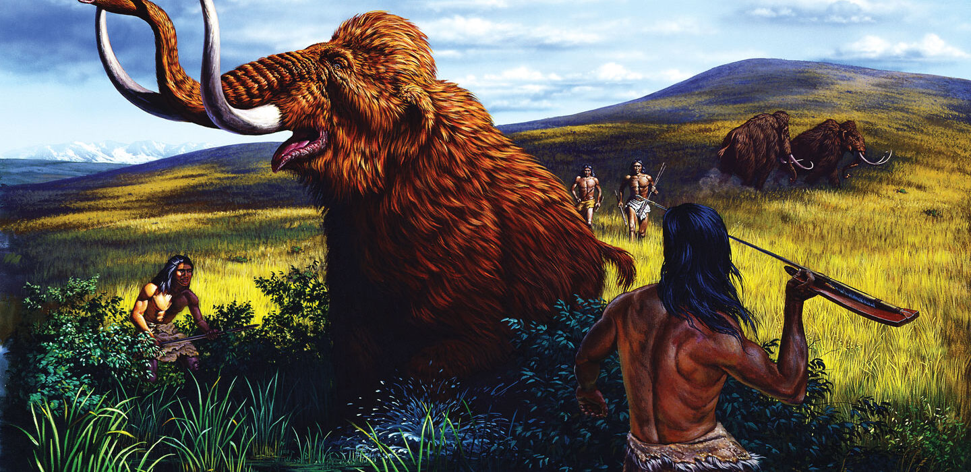
Evidence of the Clovis people ends around the time of the extinction of several of the large animals they hunted.
What ideas do you have as to why existence of both disappeared?

Slide 11
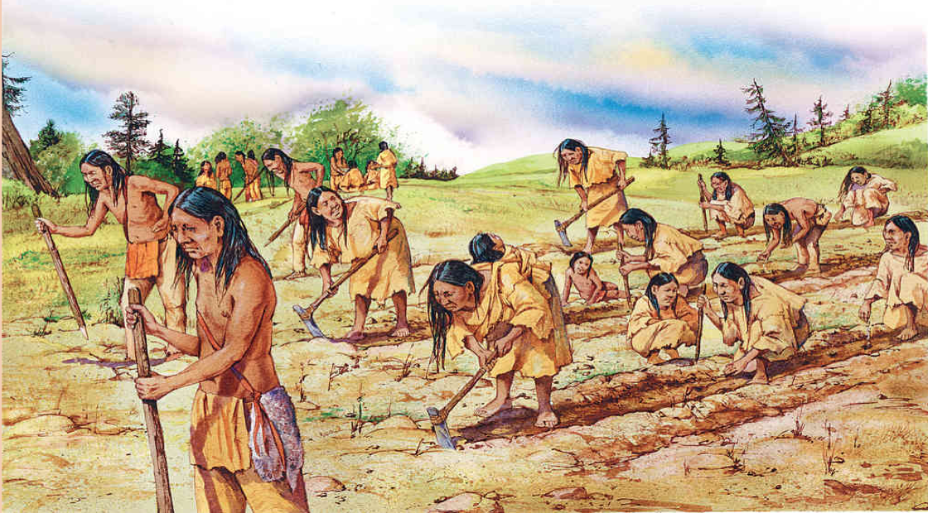
A hunter-gatherer way of life began to develop. In some areas this gradually led to a more sedentary lifestyle as the domestication of plants turned these Natives into farmers.

Slide 12
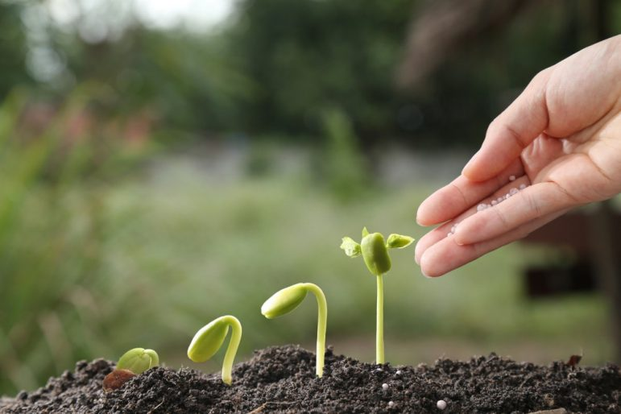
Domestication is the process of adapting plants and animals for human use.
In what ways do you think the domestication of plants helped these Native cultures flourish?

Slide 13
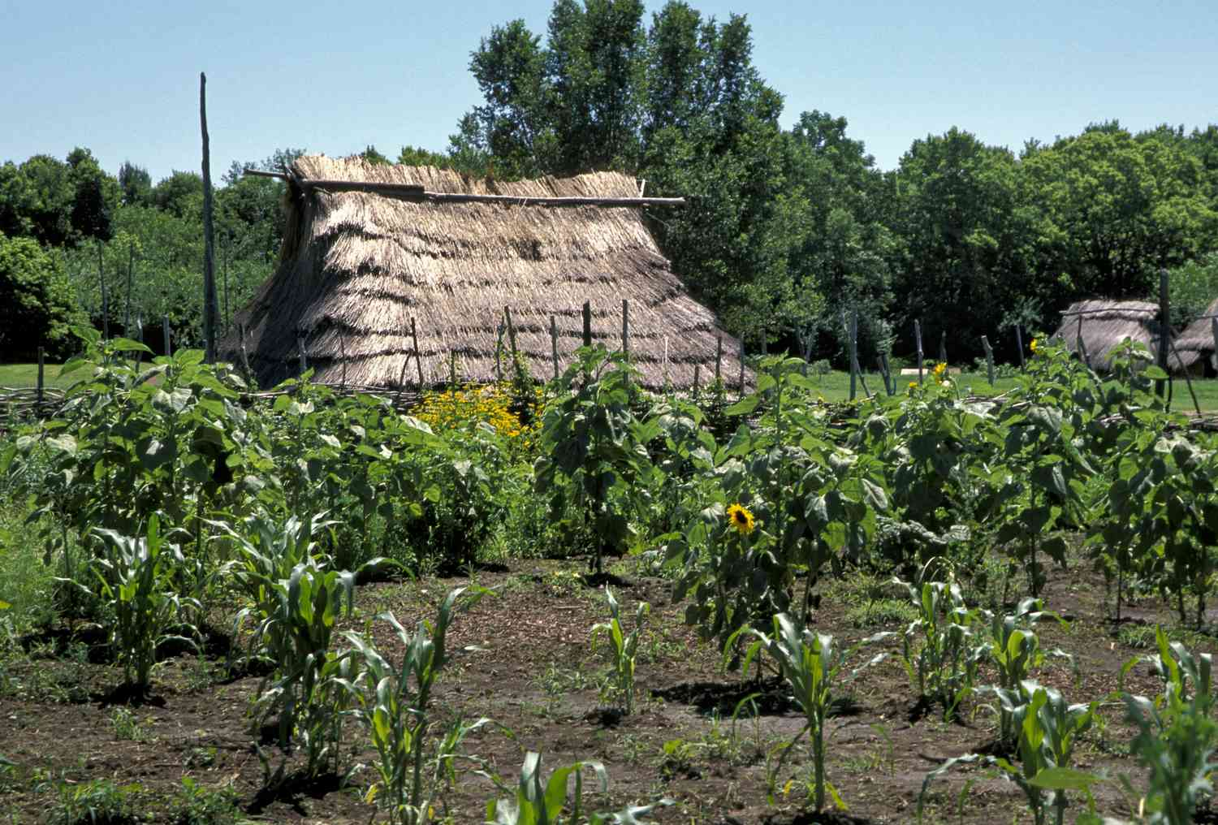
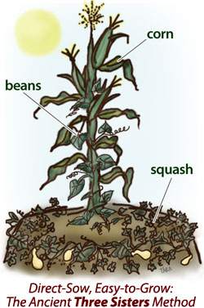
Even though hundreds of plants were domesticated, many cultures relied mostly on corn, beans, and squash, known as the “Three Sisters”.

Slide 14
Homework
Read pages 4-23.
Answer the Review Questions on pages 24-25.
Write a two-paragraph report on the Clovis culture.
OK, don’t get upset, you really don’t have to do this for homework. But what does having to do a lot of homework prevent you from doing?

Slide 15
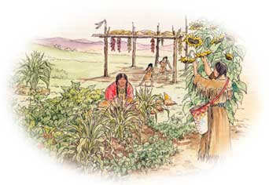
Now with a more stable food supply, people were now able to do other things which led to the development of civilizations.

Slide 16
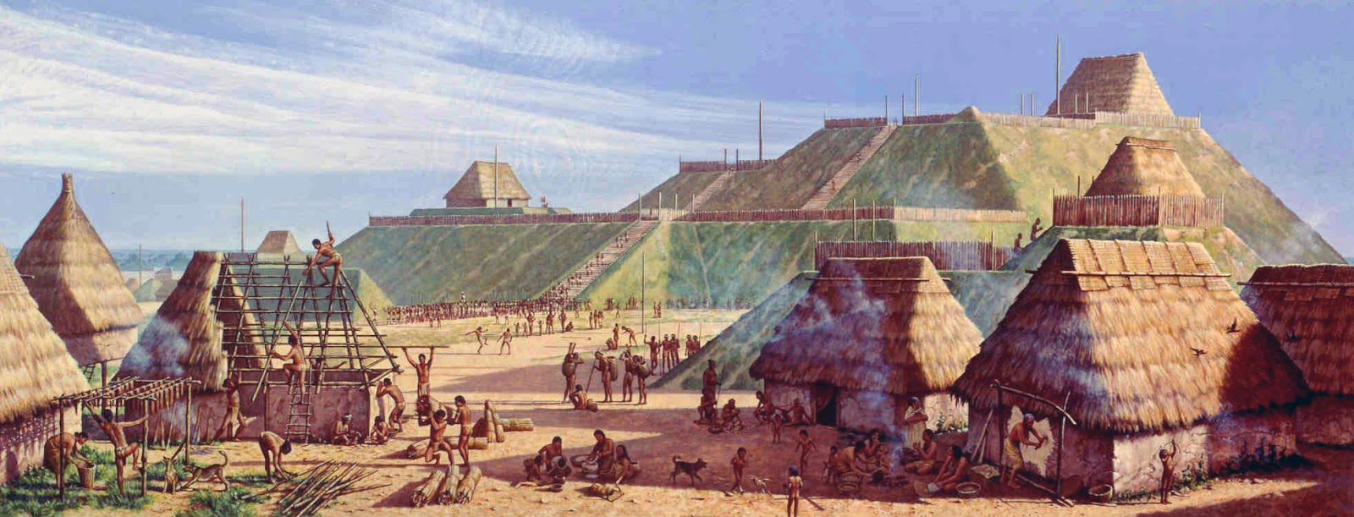
A civilization is a society with cities, specialized jobs for different people, and a complex culture.

Slide 17
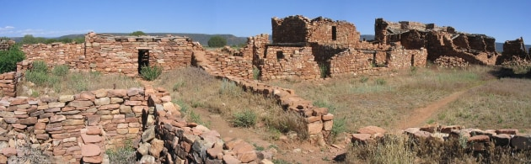
There is evidence of early civilizations in the Southwestern part of the U.S.
How do you think these civilizations were able to survive in the dry, desert conditions of the Southwest?

Slide 18
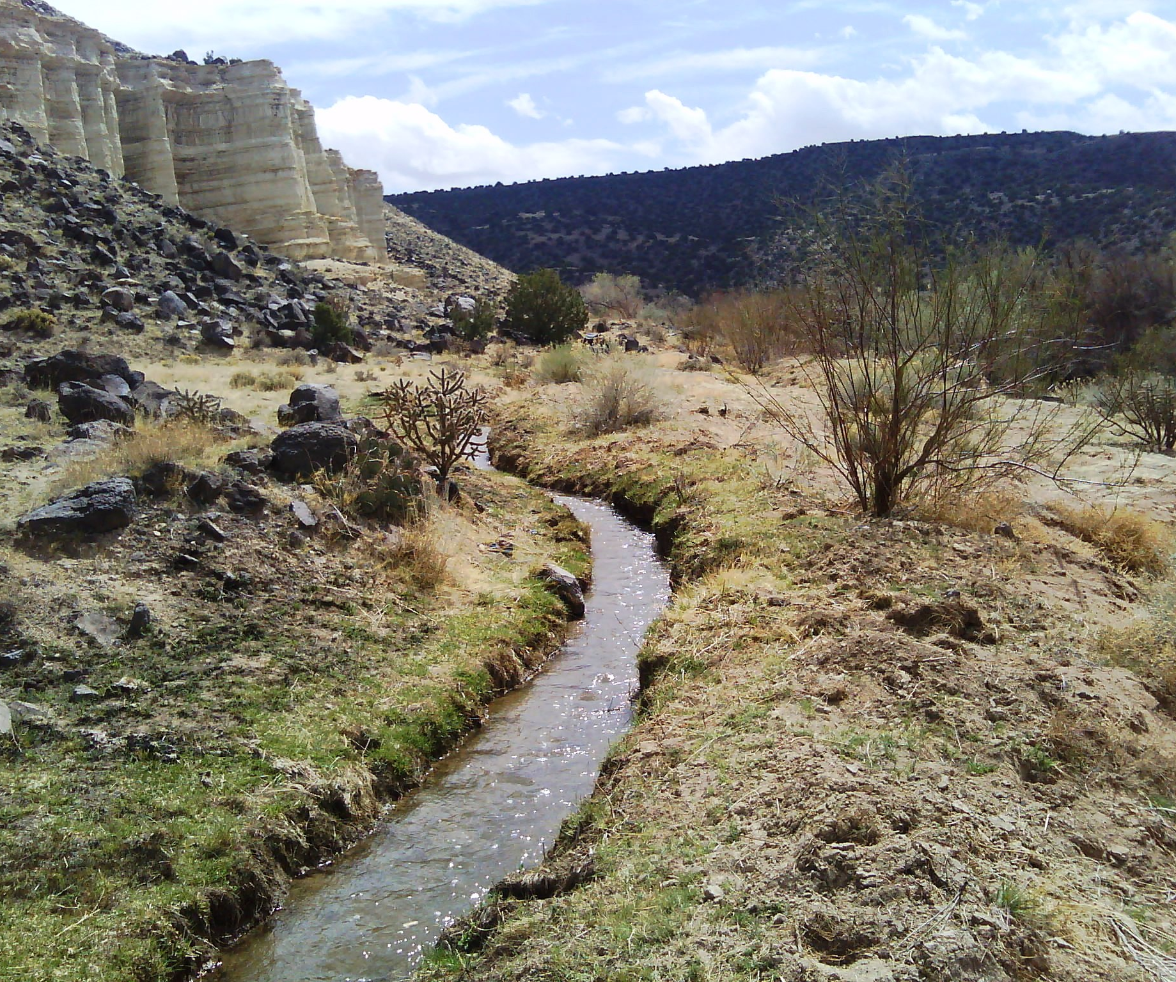
These societies had to adapt to the dry, desert conditions by building dams to collect water and digging canals to bring water to crops. This process is known as irrigation.

Slide 19
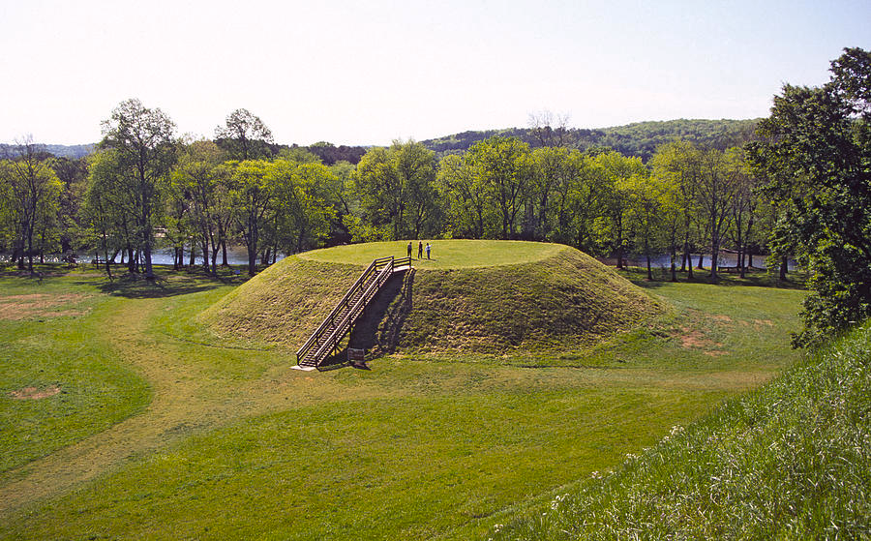
In the eastern part of the U.S. there is evidence of several different Mound Cultures that existed.

Slide 20
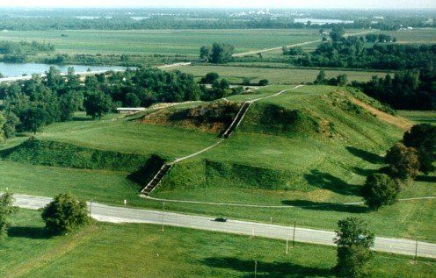
These people built large mounds of earth for different reasons. Some built them as burial sites, others for safety.

Slide 21
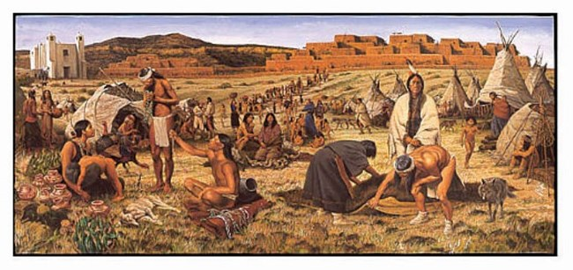
Through the evidence we have, it seems as though these ancient people travelled great distances at times, trading and interacting with other cultures.

Slide 22
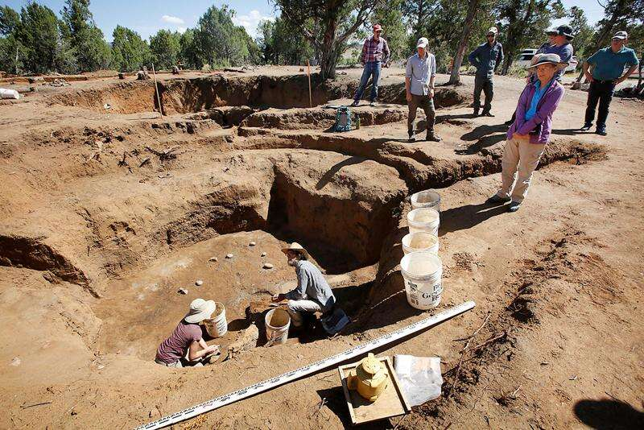
Unfortunately, we don’t know much about these civilizations, but we continue learn more and more as people make new archeological discoveries.

